Slide 1

React
Consuming API

Slide 2
# Table of Contents
Setup TMDB.
Axios.
Consuming API - Popular Movie.
Refactor - Hero Component.

Slide 3
Setup TMDB

Slide 4
# Setup
Register TMDB: TMDB - Register.
Create API Key: TMDB - API.
Save your API Key.

Slide 5
# URL
Description | URL
Documentation API | developers.themoviedb.org/3/
URL API | api.themoviedb.org/3/
URL Image | image.tmdb.org/t/p/

Slide 6
# Endpoint
Description | Endpoint
Get Popular Movie | /movie/popular
Get Top Rated Movie | /movie/top_rated
Get Now Playing Movie | /movie/now_playing
Get Detail Movie | /movie/{id}

Slide 7
Axios

Slide 8
# Axios
Promise based HTTP client for the browser and nodejs
Similar as fetch.
Third party.
Referensi: Axios - Intro.

Slide 9
# Features
Make http request from browser and node.
Promise based.
Automatic transform JSON data.
Transform request and response data.
Client side support for protecting against XSRF.
Referensi: Axios - Intro.

Slide 10
# Install
Install with npm, yarn, cdn.
Install: npm i axios.
Referensi: Axios - Intro.

Slide 11
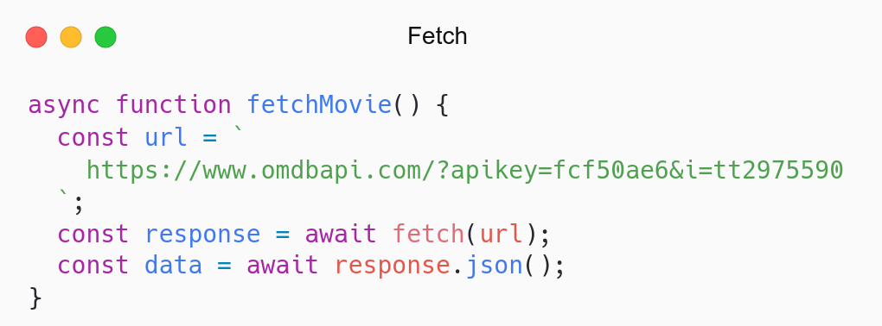
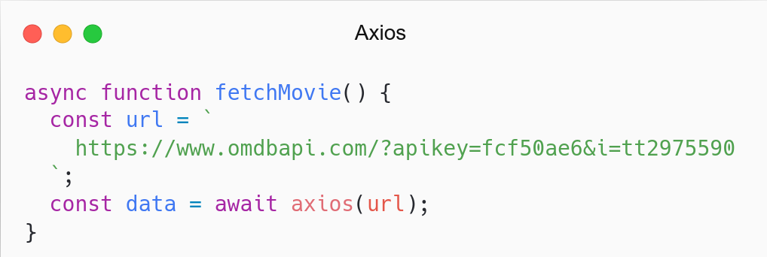

Slide 12
Environment Variable

Slide 13
# Environment Variable
Available through a global process.
Store sensitive information: api key, token, password.
Variable beginning: REACT_APP_
Create file env in root: .env
Referensi: CRA - Environment Variable.

Slide 14
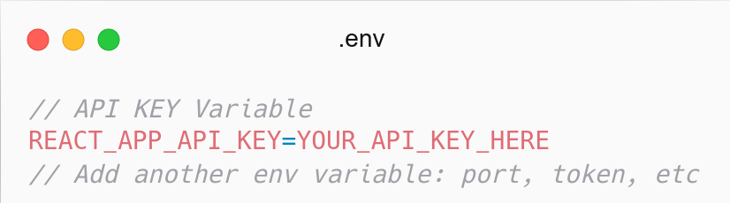
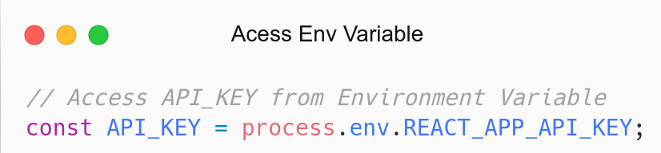

Slide 15
RESTful API

Slide 16
# API
Application Programming Interface.
Menghubungkan perangkat lunak agar saling berkomunikasi.
Example: Fetch, DOM, MySQL PHP,
Referensi: Smashing Magazine - RESTful API.

Slide 17
# REST API
API yang menggunakan arsitektur REST: RESTful API.
Digunakan untuk pertukaran data (web service).
Menggunakan HTTP (media).
Format data JSON.
Widely known as API.
Referensi: Smashing Magazine - RESTful API.

Slide 18
# HTTP Method
Method | Description
GET | Get data
POST | Add data
PUT | Update data
DELETE | Delete data

Slide 19
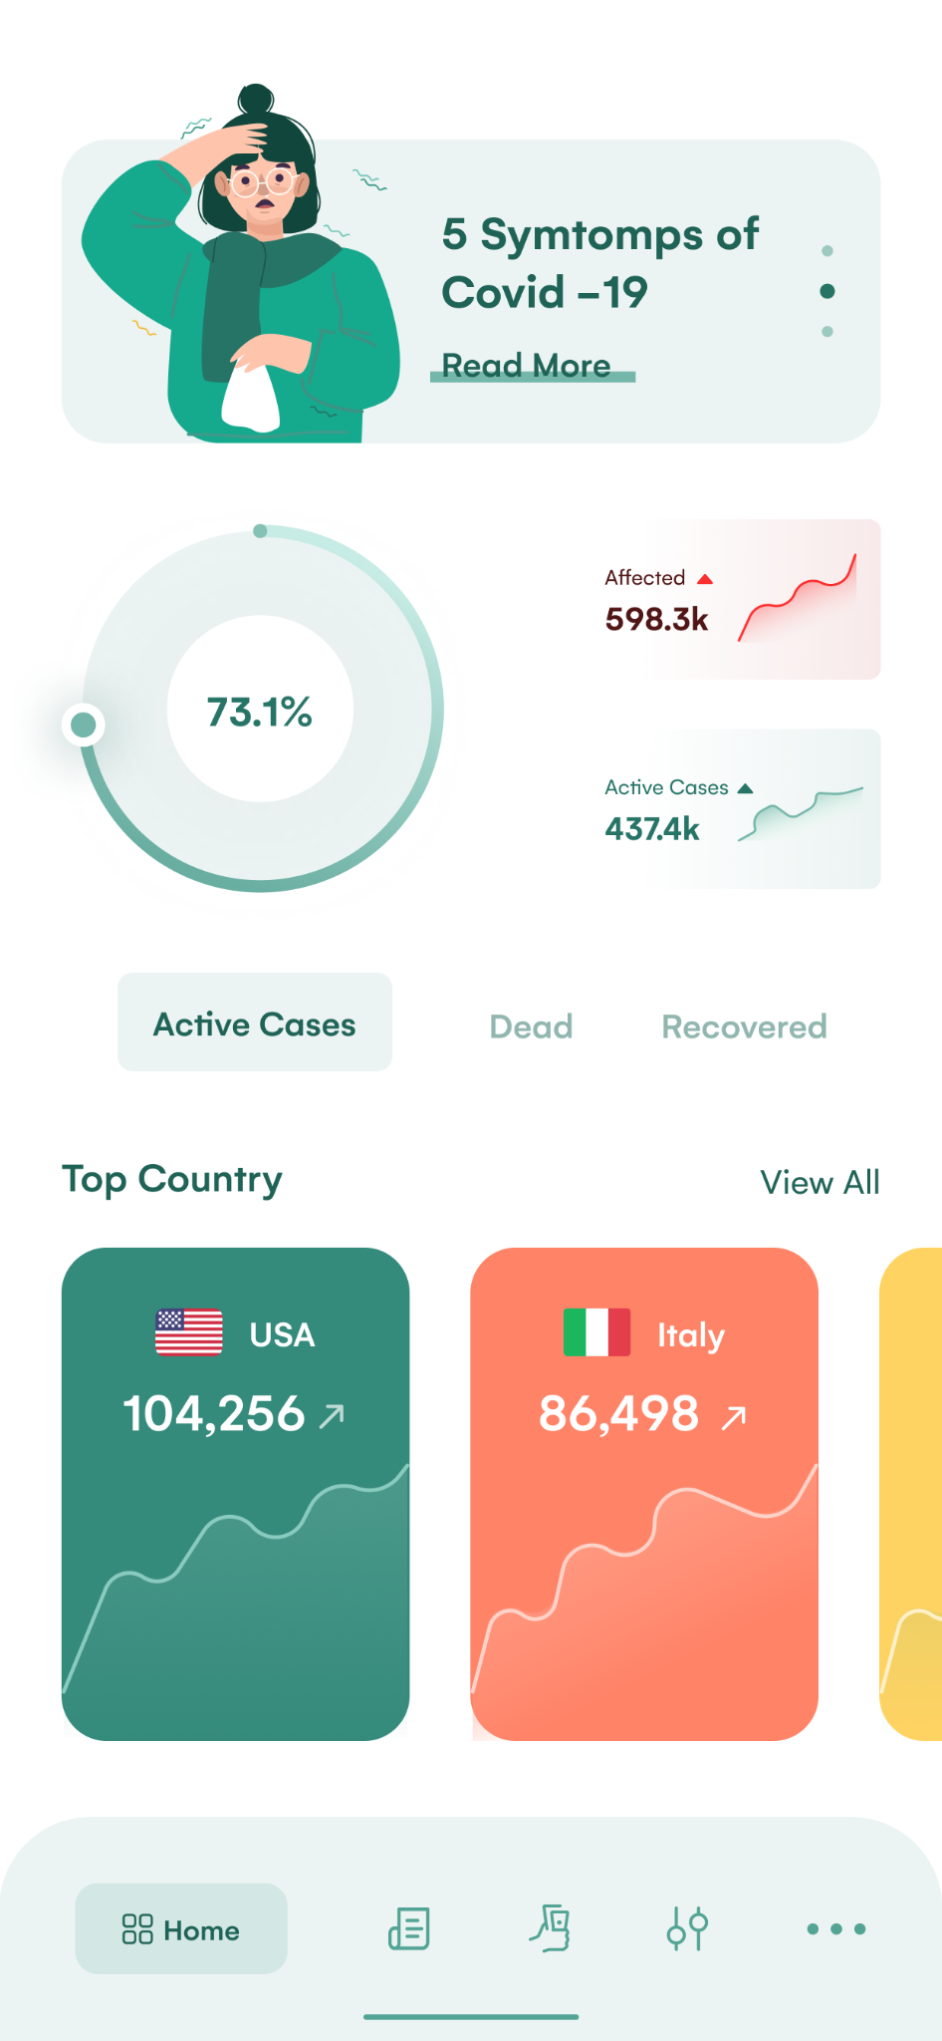
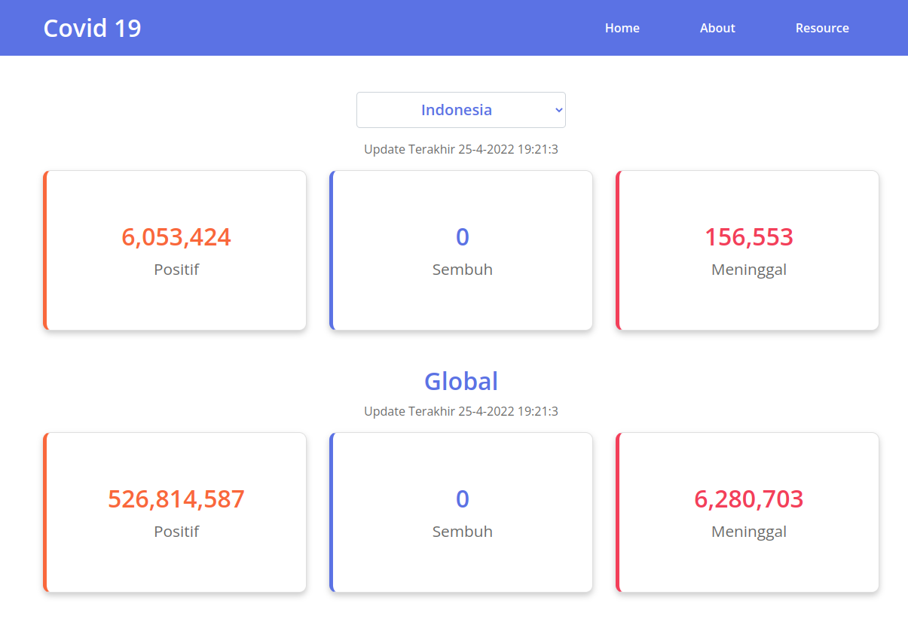
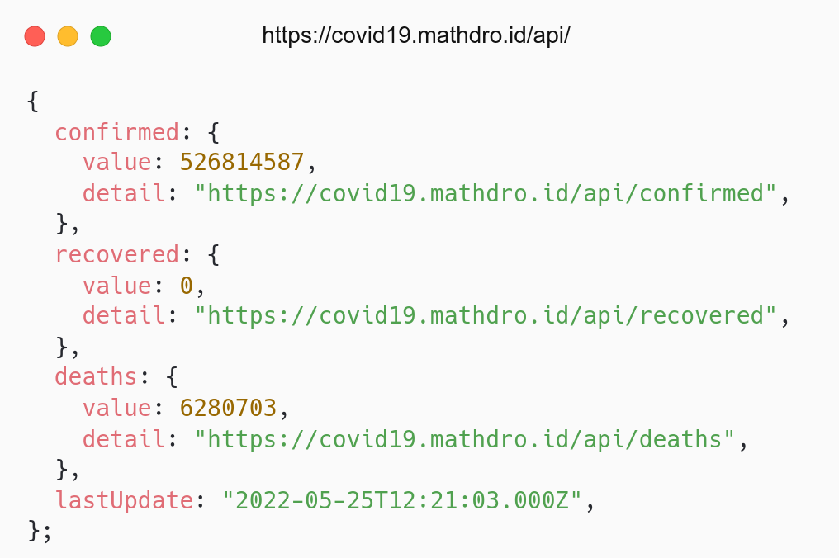
covid19.mathdro.id/api/
aufaroot18.github.io/covid19/

Slide 20
Consuming API

Slide 21
# Consuming API
Consuming API TMDB.
Create popular page (Component).
Endpoint: /movie/popular.
Referensi: React - AJAX and APIs.

Slide 22
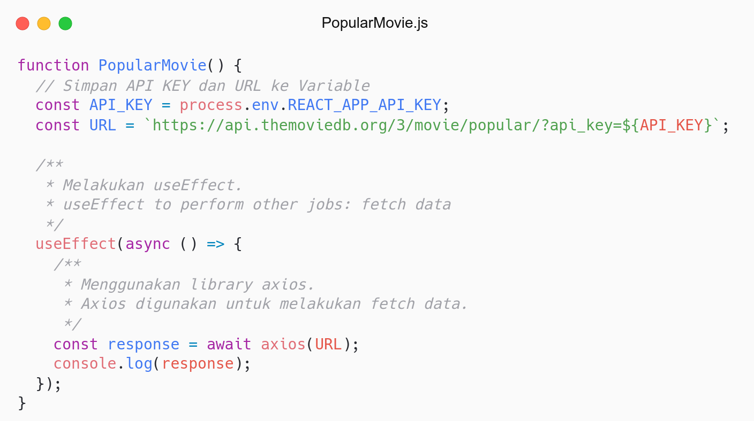
Melakukan side effects: useEffect.
Side effects: fetch data.
Fetch data menggunakan axios.

Slide 23
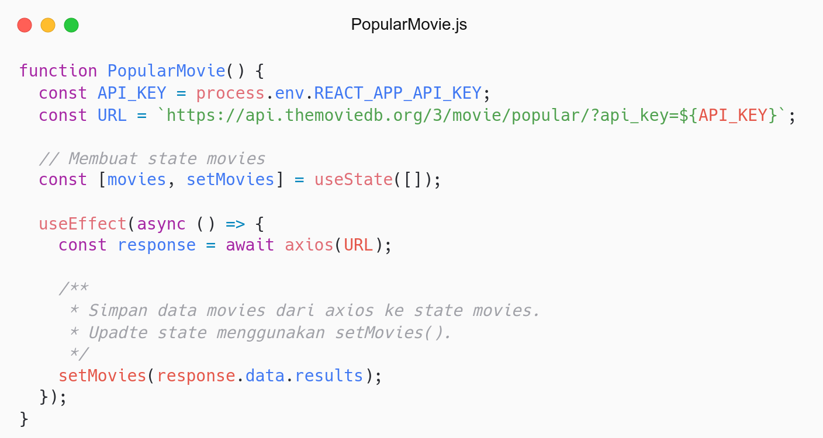
Membuat state movies.
Untuk menyimpan data movies.
Why not rendered to Movies Component?

Slide 24
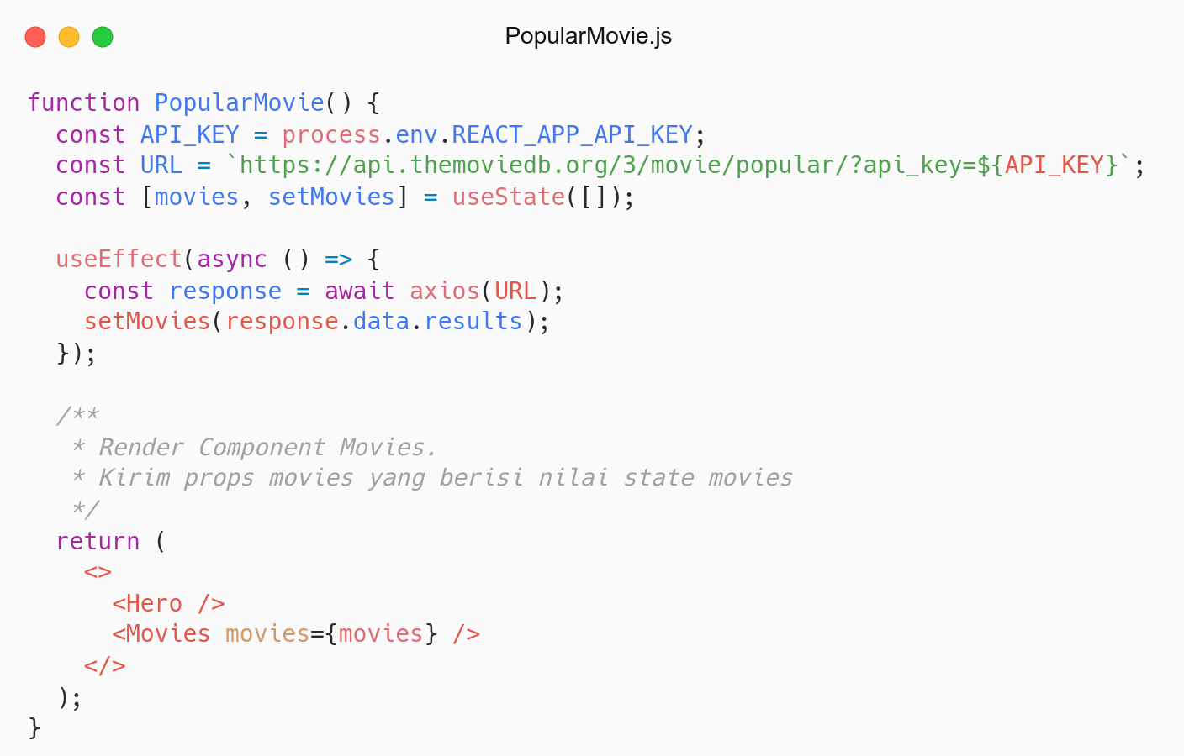
Render Movies Component.
Send movies props.
Reusable Component: Movies.

Slide 25
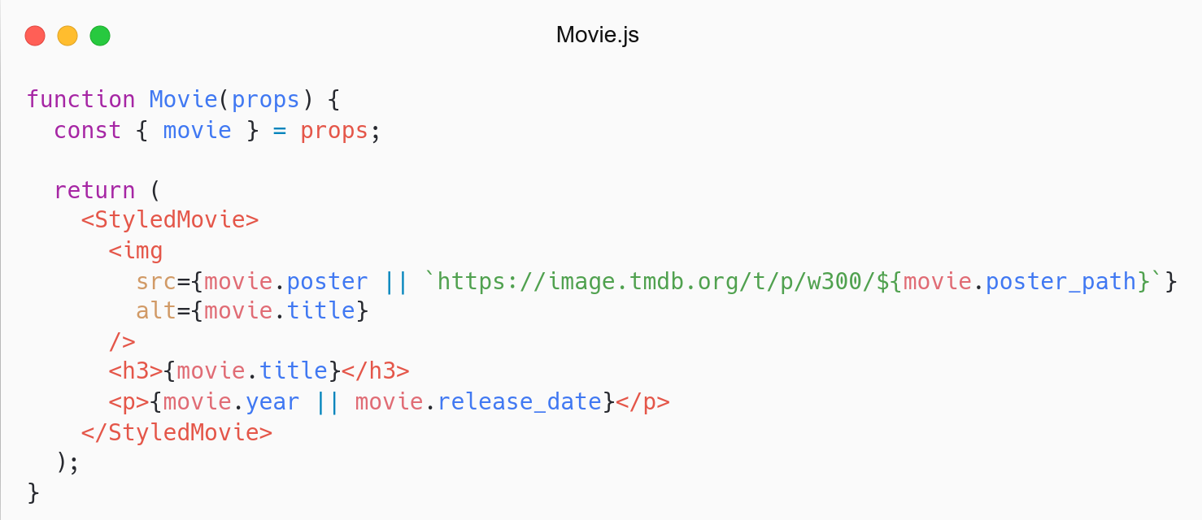
Update Movie Component.
Use data from local or API.
Nice try.

Slide 26
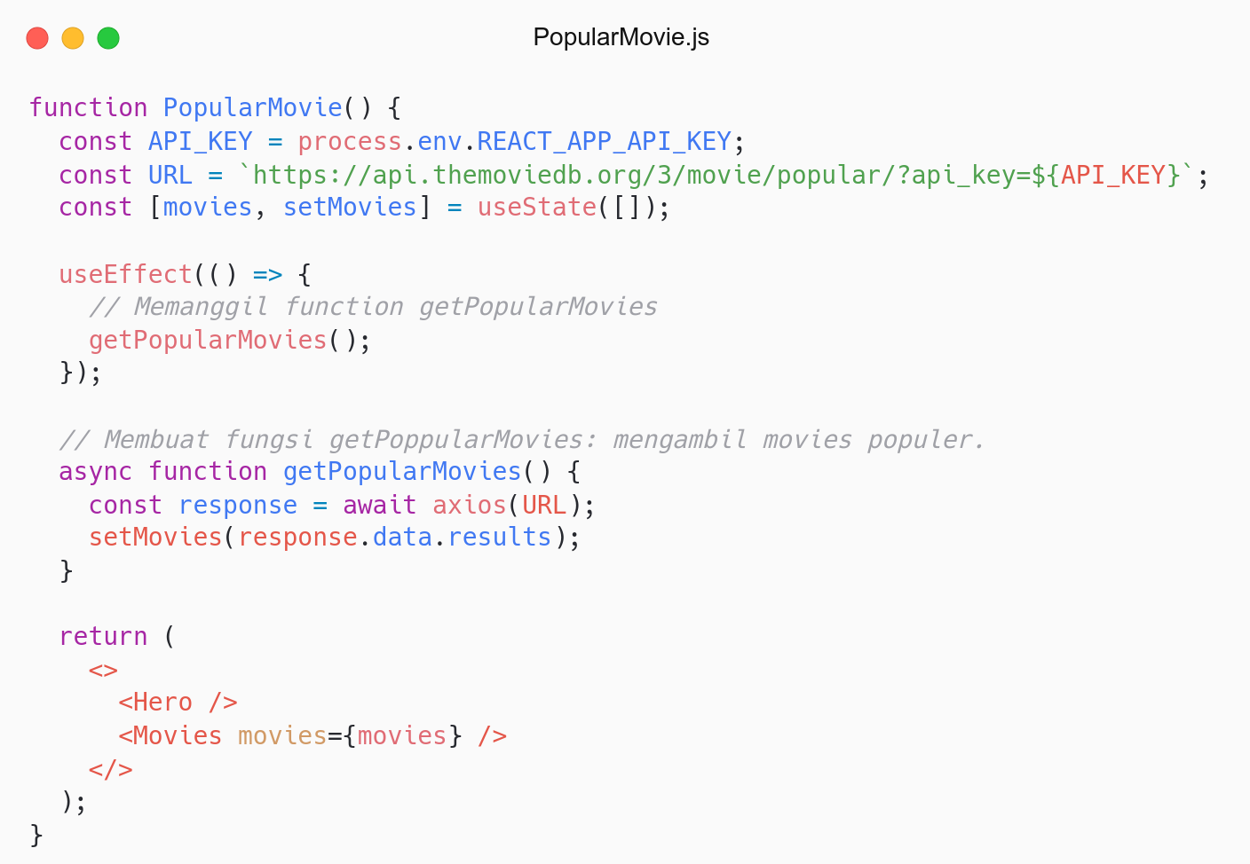
Refactor useEffect.
Move fetch task to separate function.
Clean code: function should do one thing.

Slide 27
Refactor

Slide 28
# Refactor
Refactor Hero Component.
Refactor from fetch to axios.
Use TMDB API.
Endpoint: /trending/{media_type}/{time_window}

Slide 29
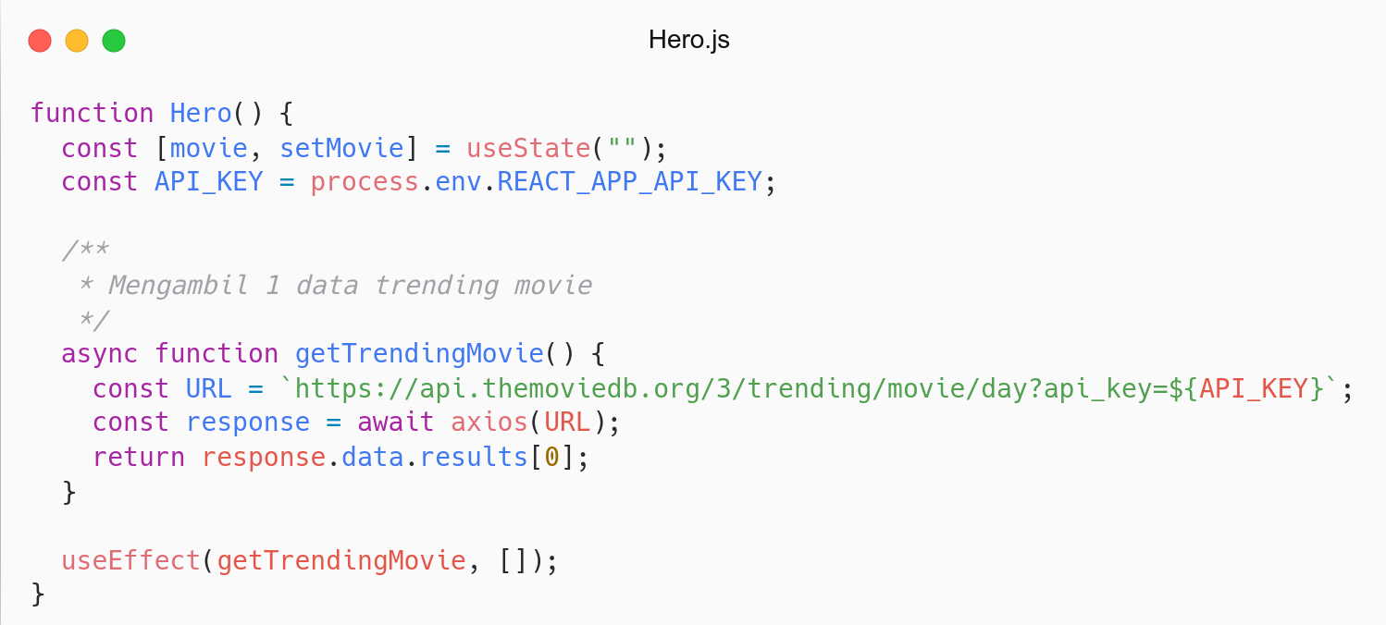
Mengambil 1 data trending movie.
Why? Data trending tidak lengkap.
Solution: Akses detail movie by id.

Slide 30
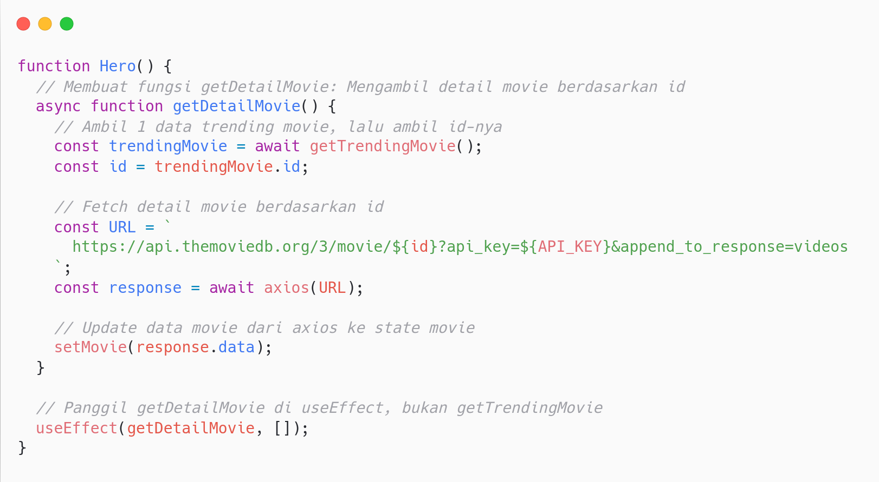
Fetch detail movie by id.
Detail movie lebih lengkap: trailer, genre.

Slide 31
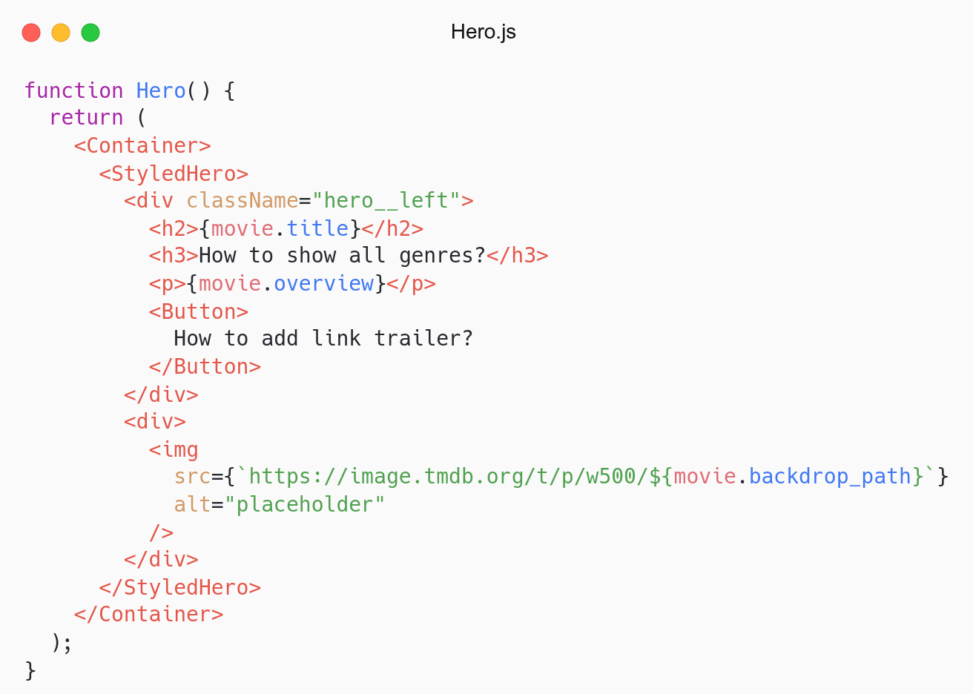
Access movie in JSX.
How to show all genres? Looping.
How to add link in Button? as polymorphism.

Slide 32
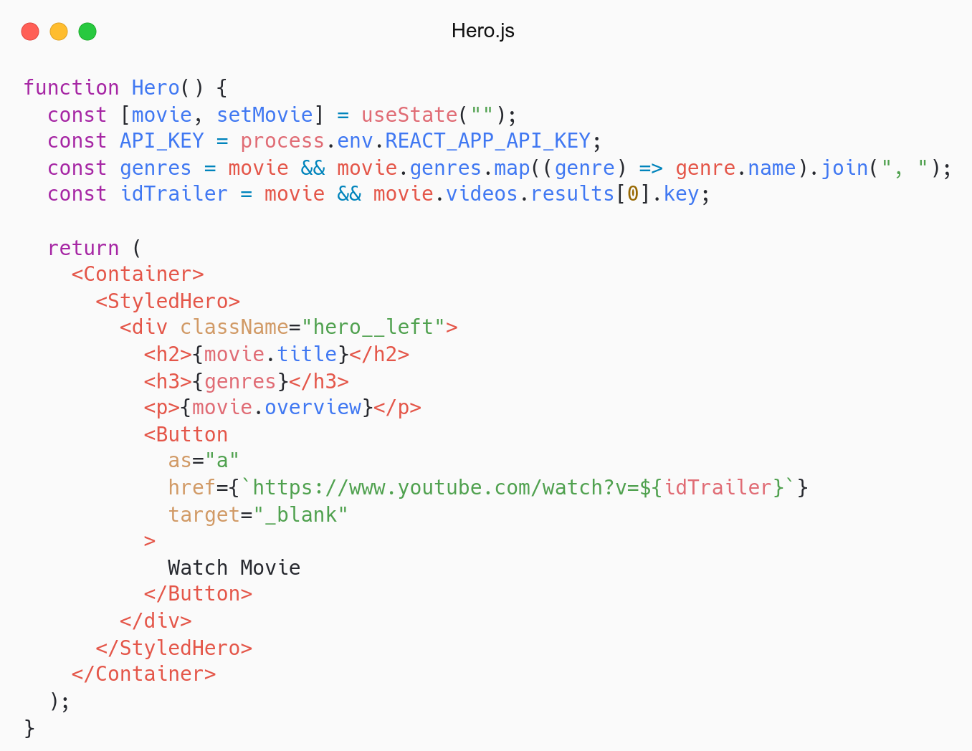
Save genres and trailer in variable.
Access genres and trailer in JSX.
Congrats.

Slide 33
QnA

Slide 34
Take Away

Slide 35
# TODO
Create NowPlaying page and fetch data from now playing api.
Create TopRated page and fetch data from top rated api.
Similar as Popular page.
Endpoint:
Now playing: /movie/now_playing
Top rated: /movie/top_rated

Slide 36
# Assignment
Push code to Repository Github (use branch for task management).
No zip and don’t push node_nodules folder.
Submit link repository to elena.
Kamis: 02 Juni 2022, Link Elena.
Jumat: 04 Juni 2022, Link Elena.

Slide 37
Attendance

Slide 38
Thanks

